Slide 1
CryptoDetails
Unit 4.3
Cybersecurity Boot Camp |

Slide 2
Today’s Goals
By the end of class, you will be able to:
Discuss the historic vetting process behind the AES Standard and the process by which DES was determined to be insecure.
Articulate the differences between Symmetric and Asymmetric encryption algorithms and their respective advantages and disadvantages.
Implement a Hybrid Cryptosystem similar to TLS/SSL.
Explain the concept of Digital Certificates and Certifying Authorities.
Notes:
Review goals; address any questions.

Slide 3
Developing Standards

Slide 4
“Black Boxes” of Cryptography
Plain Text
Encryption Technique
Cipher Text
P1
Cipher
C1
For security experts who do not work with cryptography day to day, encryption algorithms are seen as “black boxes” in which the implementation details are often abstracted away.
All we care about is that we’ve picked the most secure encryption technique available.
Notes:
Review goals; address any questions.

Slide 5
Picking the Encryption Standard
Key Algorithms
AES
Twofish
Serpant
RC6
RSA
Blowfish
DES
MARS
RC4
DSA
ECDSA
ELGamal
Diffie Helman
For newcomers to the security field, it can often seem intimidating to know which algorithm to use in an implementation project.
Hash Algorithms
MD4
SHA1
SHA2
Notes:
Review goals; address any questions.

Slide 6
Picking the Encryption Standard
Key Algorithms
AES
Twofish
Serpant
RC6
RSA
Blowfish
DES
MARS
RC4
DSA
ECDSA
ELGamal
Diffie Helman
But the process is actually simple.
Follow the standards.
Hash Algorithms
MD4
SHA1
SHA2
Notes:
Review goals; address any questions.

Slide 7
Activity: Modern Cryptography Algorithms (10 minutes)
Take a few minutes to scan through the article on this page that lists a variety of key and hash algorithms: https://rakhesh.com/infrastructure/notes-on-cryptography-ciphers-rsa-dsa-aes-rc4-ecc-ecdsa-sha-and-so-on/
As you read:
Note the types of advantages and disadvantages being flagged in each algorithm description.
Note 5 terms that look unfamiliar to you in the article and seek out their definition online.
Be prepared to share.

Slide 8
The Rise of AES
Key Algorithms
AES
Twofish
Serpant
RC6
RSA
Blowfish
DES
MARS
RC4
DSA
ECDSA
ELGamal
Diffie Helman
AES has been the recommended government standard for encryption since 2002.
Hash Algorithms
MD4
SHA1
SHA2
Notes:
Review goals; address any questions.

Slide 9
The Rise of AES
Key Algorithms
AES
Twofish
Serpant
RC6
RSA
Blowfish
DES
MARS
RC4
DSA
ECDSA
ELGamal
Diffie Helman
But it’s worth understanding the process by which it was selected.
Hash Algorithms
MD4
SHA1
SHA2
Notes:
Review goals; address any questions.

Slide 10
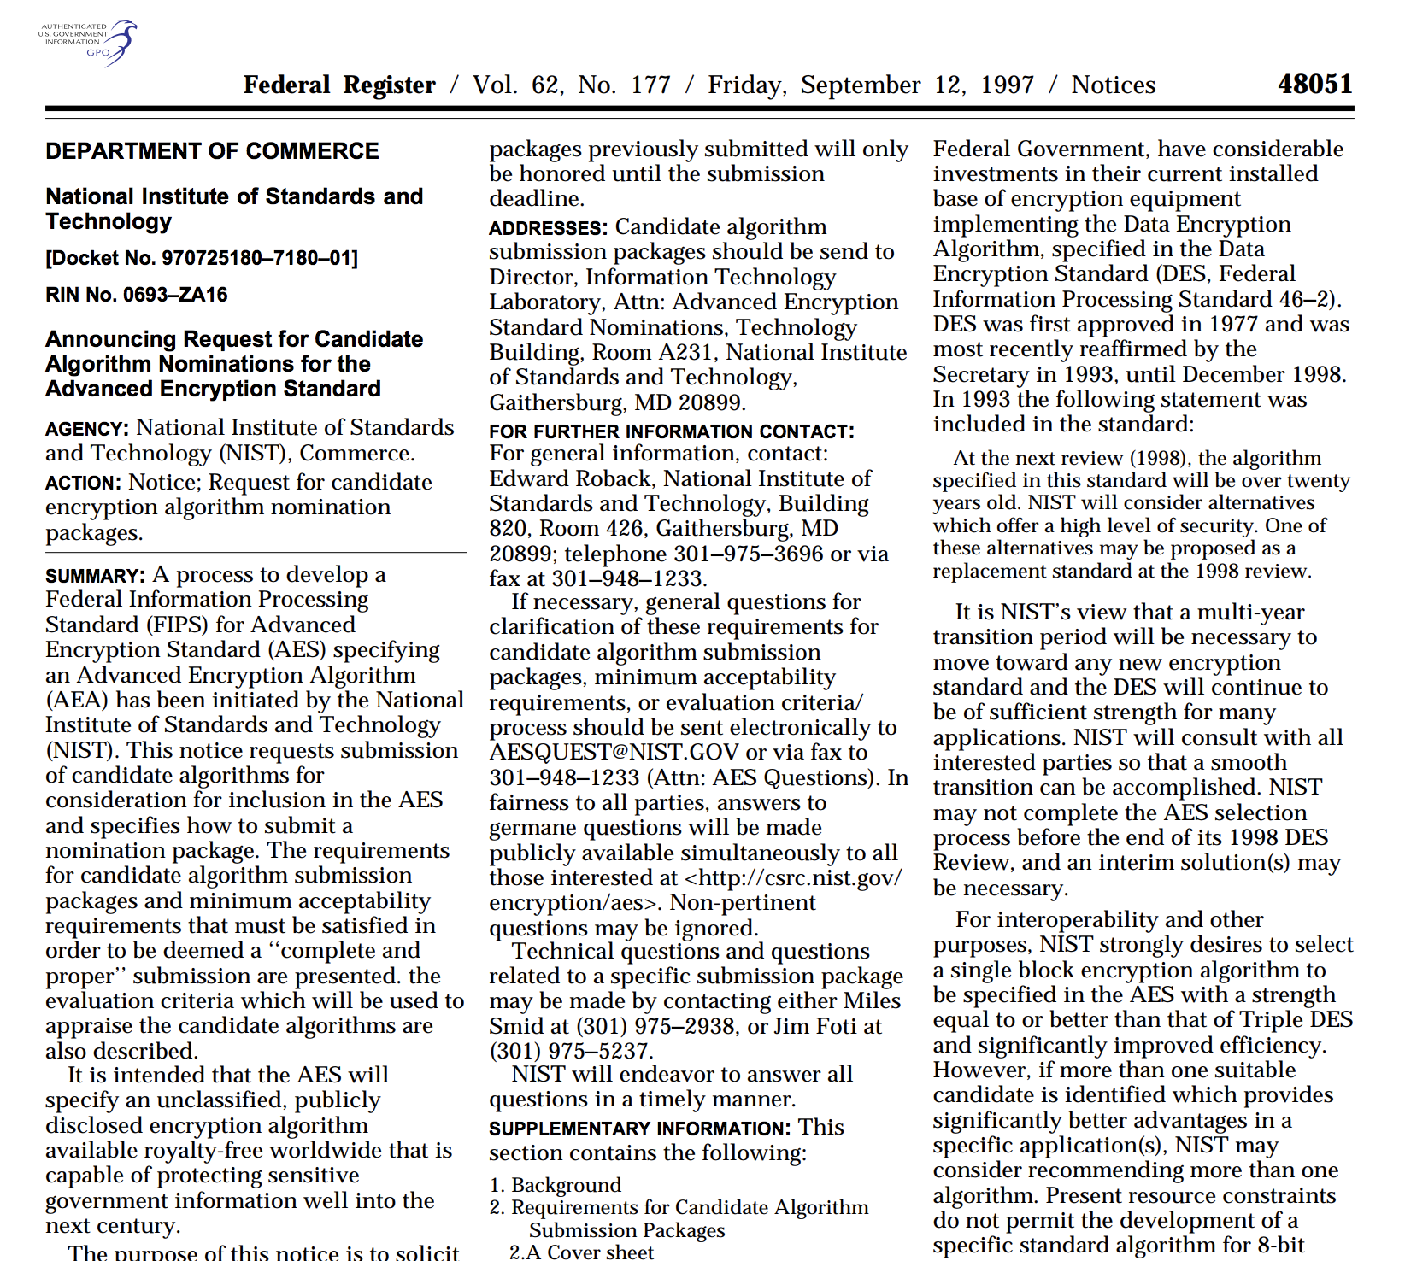
The Rise of AES
In 1997, the US Federal Government issued a call for algorithm nominations to become Advanced Encryption Standard for publicly disclosed encryption algorithm to be made available royalty free.
Notes:
Review goals; address any questions.

Slide 11
The Rise of AES
In 1997, the US Federal Government issued a call for algorithm nominations to become Advanced Encryption Standard for publicly disclosed encryption algorithm to be made available royalty free.
Notes:
Review goals; address any questions.

Slide 12
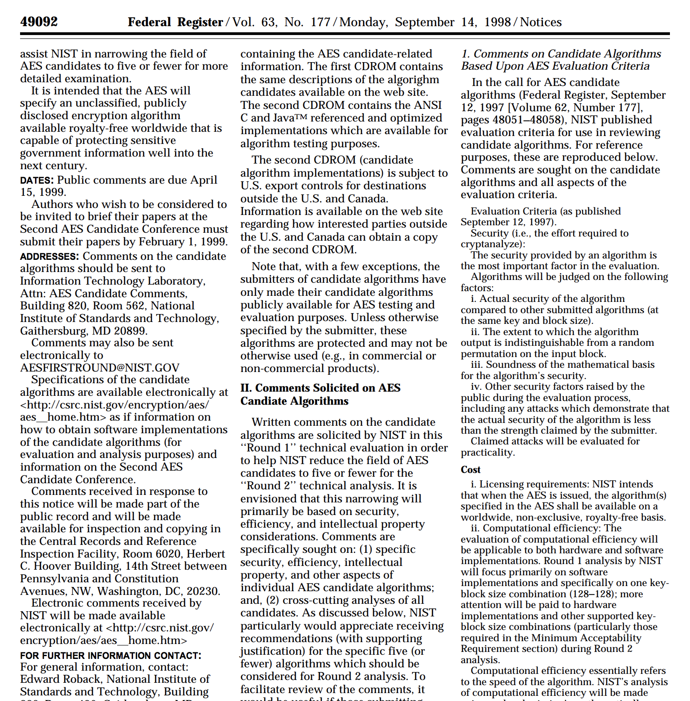
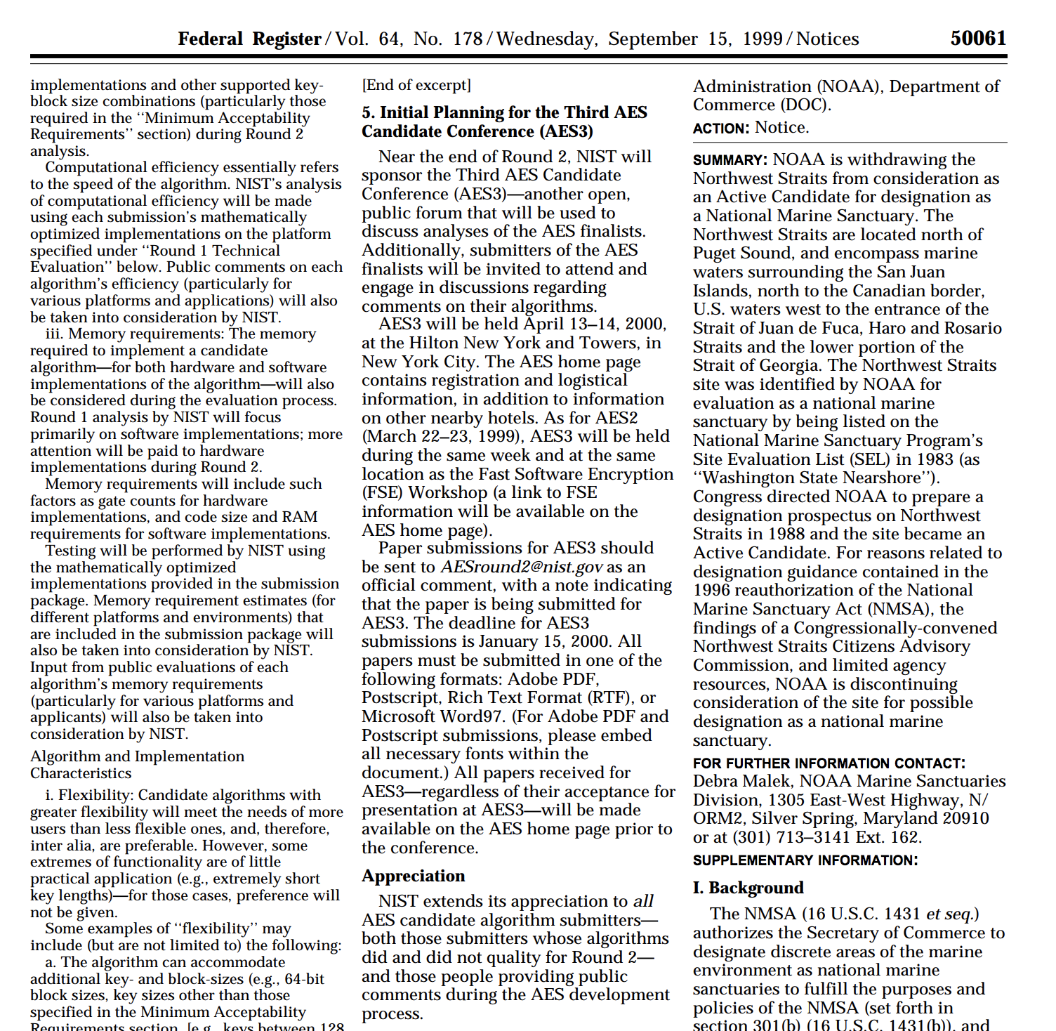
The Rise of AES
Algorithms, comments, and tests were collected from across the security community from 1997 through 2001.
Notes:
Review goals; address any questions.

Slide 13
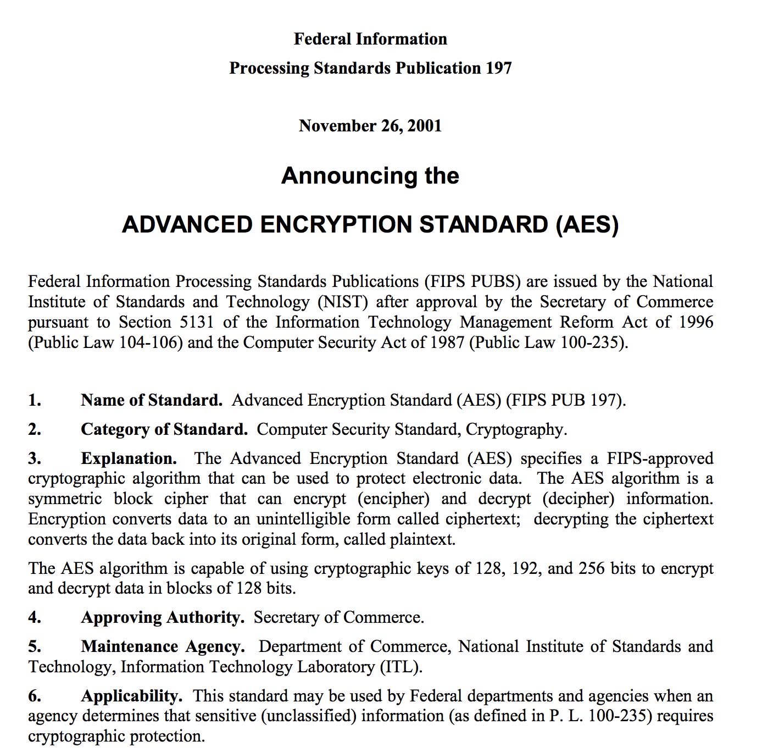
The Rise of AES
And on December 2001, an algorithm previously called Rijndael was selected as the AES Standard as part of FIPS 197.
Notes:
Review goals; address any questions.

Slide 14
Activity: FIPS 197 Read-Through (10 minutes)
Take a few minutes to flip through the FIPS 197 Announcement: https://nvlpubs.nist.gov/nistpubs/fips/nist.fips.197.pdf
Then with your partner answer the following questions:
The FIPS Standard articulates that the algorithm is a block cipher that can process data bocks of 128 bits using cipher keys of various lengths. What does this mean in plain English?
The FIPS Standard seems to go into extensive depth about how the algorithm works. Doesn’t this create a risk that hackers will figure out how to break it?

Slide 15
Picking the Wrong Encryption Standard
Key Algorithms
AES
Twofish
Serpant
RC6
RSA
Blowfish
DES
MARS
RC4
DSA
ECDSA
ELGamal
Diffie Helman
While the process unveiled the modern AES system, similar research has also been critical in identifying which cryptography algorithms are not secure.
Hash Algorithms
MD4
SHA1
SHA2
Notes:
Review goals; address any questions.

Slide 16
Activity: DES Death Match (15 minutes)
Take a few moments to read through the article The Day DES Died (https://www.sans.org/reading-room/whitepapers/vpns/day-des-died-722).
Take notes as you go specifically around:
What DES? Why it was important? And how it was determined to be insecure.
5 terms or topics included in this document that you were unfamiliar with. (Research their definition).

Slide 17
Symmetric vs Asymmetric

Slide 18
Symmetric vs. Asymmetric Overview
A critically important concept in cryptography lies in understanding the difference between Symmetric and Asymmetric Encryption.
Notes:
Review goals; address any questions.

Slide 19
Symmetric Cryptography (In-Depth)
In symmetric encryption, a single key is used to both encrypt and decrypt plain text to cipher text and vice versa
Notes:
Review goals; address any questions.

Slide 20
Asymmetric Cryptography (In-Depth)
In asymmetric encryption, two separate keys are used. A public key is used to encrypt data, while a private key is used to decrypt data.
Notes:
Review goals; address any questions.

Slide 21
Activity: Advantage / Disadvantages Pt I (10 minutes)
Thought Exercise!
For the next 10 minutes, talk to your partner about the following questions:
What might be 3-5 advantages of using a symmetric encryption system?
What might be 3-5 advantages of using an asymmetric encryption systems?
When might you use each?
For this exercise do NOT use research. Think about this first!

Slide 22
Activity: Advantage / Disadvantages Pt II (10 minutes)
Research Exercise!
Now take ten minutes to use research to confirm or deny your assumptions. Try to add 1-2 additional reasons or use cases for each.
Be prepared to share both your hypothesized ideas and your research results.

Slide 23
Activity: Sym Vs. Asym Scenarios (15 minutes)
Working with the person next to you, determine whether a symmetric or asymmetric encryption is the most sensible solution for each of the situations provided.
Be prepared to share your rationale.

Slide 24
Data in Motion

Slide 25
Keeping Secrets… Secret?
Thus far, we’ve talked a lot about the overall encryption mechanism – how they convert plain text into cipher text and how keys can be used to do the back and forth. But an important question remains…
Notes:
Review goals; address any questions.

Slide 26
Keeping Secrets… Secret?
How do you deliver the key?
Notes:
Review goals; address any questions.

Slide 27
Activity: The Key Exchange Problem (10 Minutes)
With the person next to you, play out the following scenario:
Imagine you have deeply sensitive data to share with your seat partner, like the location of a winning lottery ticket you've decided to split amongst yourselves; a coupon for a dozen, free Sublime Donuts (arguably more valuable than the lottery ticket); etc.
As security pros, you'd naturally encrypt this data using some modern standard like AES. Of course, this requires that you use a key to encrypt your message, and that your partner uses the same key to decrypt it.
But there's a problem. You realize that you remembered to give them your secret message after the last class, but forgot to give them the key before heading back home.
Here's the question: Can you think of a way to get your key to them, while guaranteeing that no one else could get their hands on it?
Try to come up with at least 3-5 different pathways for this.

Slide 28
Keys for Keys…
Plain Key
Encryption Technique
Cipher Key
P1
Cipher
What if we encrypted the key?
Notes:
Review goals; address any questions.

Slide 29
Keys for Keys…
Truer words never said.
Notes:
Review goals; address any questions.

Slide 30
Hybrid Cryptosystems
The concept we’re leading to is the basis by which modern cryptography systems like AES center.
In this system we use two separate encryption processes:
Key Encapsulation: In this step, we use an asymmetric cryptosystem to generate an encrypted key.
Data Encapsulation: In this step we use the encrypted key generated as a symmetric key for data.
What this allows for us is the ease of symmetric encryption when it comes to data, while maintaining the added security of asymmetric encryption.
Notes:
Review goals; address any questions.

Slide 31
Hybrid Cryptosystems - Diagram
Key Encapsulation (Asymmetric Encryption)
Plain Key
Public
Encapsulating Key
Plain Key
Encrypted Encapsulating Key
Private
Encapsulating Key
Encrypted Encapsulating Key
Data Encapsulation (Symmetric Encryption)
Plain Text
Encrypted Encapsulating Key
Cipher Text
Notes:
Review goals; address any questions.

Slide 32
Hybrid Cryptosystems - Diagram
Key Encapsulation (Asymmetric Encryption)
Plain Key
Public
Encapsulating Key
Plain Key
Encrypted Encapsulating Key
Private
Encapsulating Key
Encrypted Encapsulating Key
Data Encapsulation (Symmetric Encryption)
Plain Text
Encrypted Encapsulating Key
Cipher Text
Take a minute with this.
Notes:
Review goals; address any questions.

Slide 33
Activity: Diagramming Hybrid Cryptosystems (10 minutes)
We hope you got that… because for your next task, we’d like for you to diagram the basic architecture of a hybrid cryptosystem.
As you lay out the components, turn to the person next to you to confirm they too can define and contextualize each of the following:
Key Encapsulation
Data Encapsulation
Symmetric Encryption
Asymmetric Encryption
Public Key vs Private Key

Slide 34
Activity: Implementing Hybrid Systems (25 minutes)
For the next 25 minutes, we’re going to embark on a challenging process of implementing our own cryptosystem.
Use your instructors’ guidance and instructions sent to you over slack to proceed.

Slide 35
Beyond Encryption

Slide 36
Level-Setting Our Understanding
At this point, you should roughly understand:
How ciphers can be used to convert data into encrypted data.
How keys can be used in a symmetric or asymmetric way.
How we can use ciphers to encrypt keys.
How we can use a hybrid cryptosystem to ensure keys are in available to both the sender and the receiver.
Now it’s time to understand how this works in practice.
Notes:
Review goals; address any questions.

Slide 37
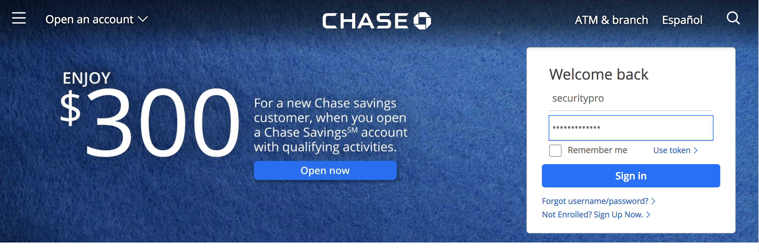
Encryption in Practice
Let’s say I’m logging into my bank.
When I “Sign-In”, my computer will begin communicating with the Chase Server. (We’ll talk more about this later in the course).
In this example, my computer is the sender and the server is the receiver.
Notes:
Review goals; address any questions.

Slide 38
Encryption in Practice
Step 1: Chase Generates the Encrypted Key We’ll Use
Chase Bank
Public
Encapsulating Key
Encrypted Encapsulating Key
Step 2: I’ll Encrypt My Data Using the Key and Vice Versa
My Login Info
Encrypted Encapsulating Key
My Encrypted Login Info
Is that it?
Notes:
Review goals; address any questions.

Slide 39
Encryption in Practice
Step 1: Chase Generates the Encrypted Key We’ll Use
Chase Bank
Public
Encapsulating Key
Encrypted Encapsulating Key
Step 2: I’ll Encrypt My Data Using the Key and Vice Versa
My Login Info
Encrypted Encapsulating Key
My Encrypted Login Info
Is that it? …Not quite.
Notes:
Review goals; address any questions.

Slide 40
Securing Data in Motion
A critical component left to examine is the idea of Securing Data in Motion. Critical to understanding this is the TLS/SSL Handshake.
Notes:
Review goals; address any questions.

Slide 41
Activity: Safe Handshakes (10 minutes)
Take a few minutes to review the contents included on this site: https://www.ssl.com/article/ssl-tls-handshake-overview/
Specifically, try to glean the role TLS/SSL plays in conjunction with the hybrid cryptosystems we discussed earlier.

Slide 42
Securing Data in Motion
The SSL/TLS Handshake process ensures that data flows from the client to the server in such a way that the keys (and pre-keys) are being transmitted in phased steps.
This phasing of operations ensures that every check is made prior to data transmission occurring.
Notes:
Review goals; address any questions.

Slide 43
Certificates (Time Permitting)

